Slide 1
Image to Texture
MJ Kim
Seongho Cho

Slide 2
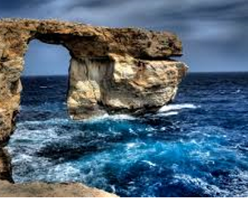

Our goal was….

Slide 3
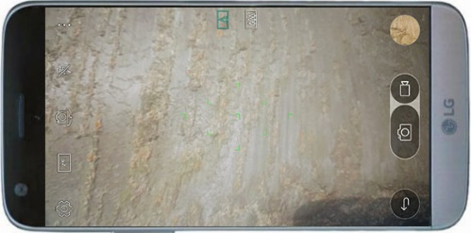




Our goal was…(2)
Take a picture
User
Surface Feature Recognition
Texture Rendering
Haptic Effect

Slide 4
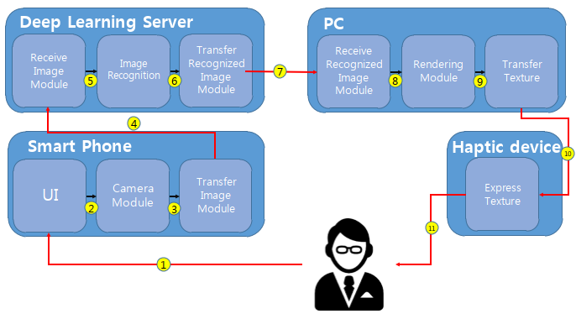
Structure Design

Slide 5
Perspective of HCI principles
Attributes | HCI principles | Impacts
By hand | Usability, Usefulness | (+) Easy to use (+) Don’t have to learn (+) Intuitive to use (-) Reachable distance (-) Could get virus
By image to texture | Usefulness, Affective | (+) Could feel the unreachable object (+) Affect of technology (-) Must have the haptic device (-) Have to feel the texture by unexperienced way

Slide 6
Demonstration

Slide 7


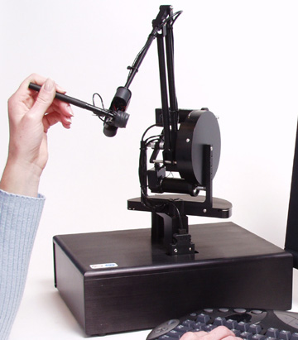
Hardware

Slide 8




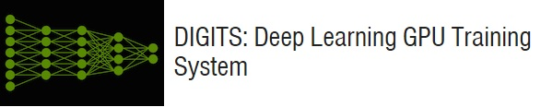
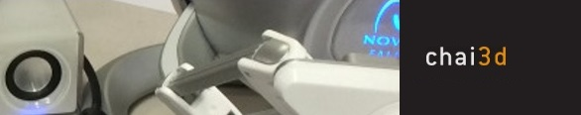
Software

Slide 9
Thank you

